Slide 1
Twitter for Professional Learning
Jennifer Malone, Loudon County Schools
Twitter:
@jenmalonetn
#TETAATA

Slide 2
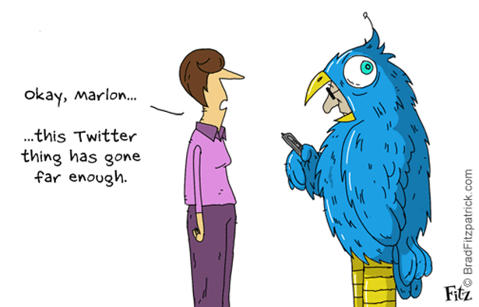

Slide 3
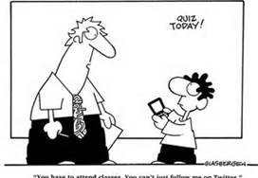
“You have to attend classes. You can’t just follow me on Twitter.”

Slide 4
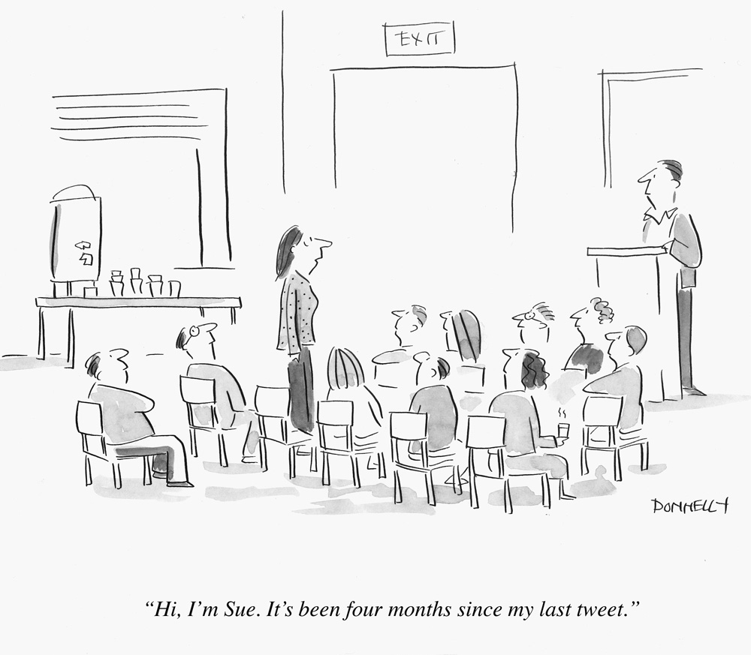

Slide 5
Why Should I Use Twitter????
SHARE
What is obvious to you may be amazing to someone else.
PLN
Establish an international network of colleagues.
Sounding Board
Not sure what to do? Ask!!!
Public Relations
Let people know the good things.
In the Know
Helps you stay in touch with latest trends and ideas

Slide 6
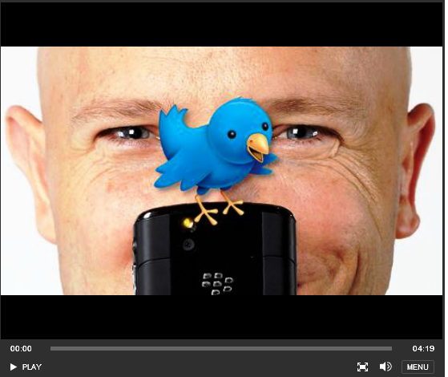
Eric Sheninger Video

Slide 7
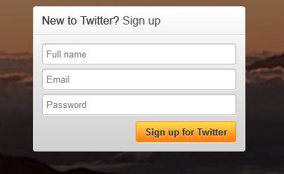
Getting Started
Go to www.twitter.com and sign up for an account if you don't already have one.
Name: For the sake of transparency, you are encouraged to use your full name. If you aren't comfortable with that yet, at least put your first name and last initial.
Email: Depending on your account settings, you may get a lot of email from Twitter. Also, you need to take into account any social media policies your employer has in place. I recommend using a personal email address when you first sign up so the account is not tied to your employment in any way.
Password: Please choose a strong password. Something you can remember but isn't easy for someone else to guess.

Slide 8
Choose Your User Name
When you first set up your account, Twitter will ask you to choose a username/handle. This is how others will come to know you on Twitter.
Your username can be key in building a network on Twitter. It can be simple, like your last name and first initial, but it can also say something about why you are on Twitter.
All Twitter usernames must be unique, so it may take a couple of tries for you to find one that works.
Your username can be changed later, although it's best to do this before you get too many followers so they don't get confused.

Slide 9
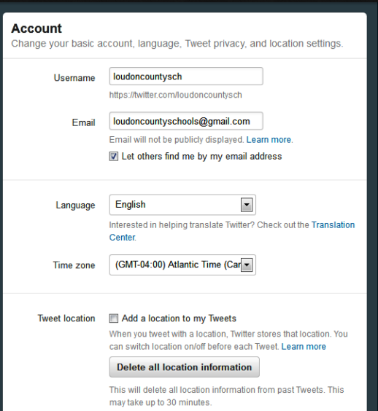
Account Settings
On the Account page, found under Settings, you will need to make some decisions.
Username & Email: This is where you will come later if you want to change your username or the email address associated with your account.
Let Others Find Me By My Email Address: I recommend NOT checking this since you are trying to connect mostly with other professionals and not your friends who might have your email address.
Language & Time Zone: Select what is correct for you.
Tweet Location: I recommend NOT checking because this will literally tell the world exactly where you are when you Tweet. If tweeting from home, this could reveal your home location. If Tweeting from your mobile phone, it could let others know exactly where you are.

Slide 10
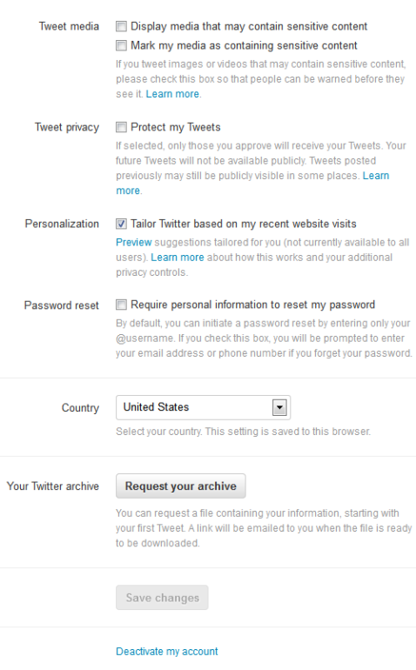
Account Settings
Tweet Media: I recommend Not checking either of these unless you are planning to use Twitter for "other" reasons.
Protect my Tweets: This setting is up to you. If you check it, only people who follow you can see your Tweets. People who want to follow you will need to be approved by you. Checking this will slow down the building of your network.
Personalization: Up to you. Probably leave unchecked to start.
Password reset: Leave unchecked.
Country: USA
Twitter Archive: Use this later
Save Changes

Slide 11
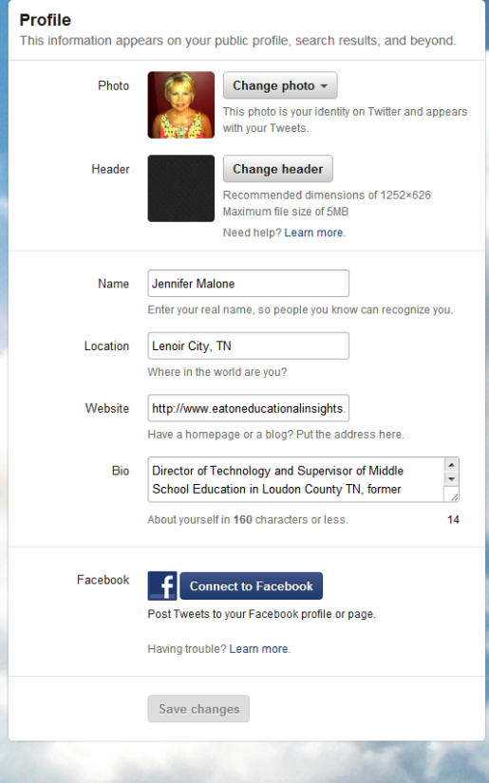
Your Profile
Your Profile is another key to helping you connect with folks who have interests similar to yours on Twitter. When you follow someone, they will likely look at your profile to make sure they want you getting their Tweets. Followers can be blocked (more on that later.)
Picture: As soon as you can, plan to upload a picture or avatar that represents you. The generic Twitter egg is a dead giveaway of a Twitter newbie and often spammers who don't bother with a profile pic. Choose your photo carefully; make sure it is professional and you are comfortable with the planet seeing it.
Name: Again, full name is most transparent. You can just do first name if you want, or put your Twitter username here (like I did at first) until you get comfortable.
Location: Be as specific as you want. Remember, everyone can see this. Can also be left blank.

Slide 12
Your Profile
Web: If you have a website that represents you personally, put it here. I would not put a school website unless your social media policy allows it and/or you have specific permission from an administrator. This can be left blank.
Bio: The most important part! This lets folks know what you are interested in. This, combined with the Tweets you post, will most often be the determining factor in whether someone decides to follow you and/or block you. If possible, include that Tweets represent you, not your employer.
Post your Tweets to Facebook: Highly do NOT recommend. Every Tweet will become a status update on your Facebook profile. A good way to annoy your Facebook friends!
SAVE CHANGES

Slide 13
Other Settings
Password: Where you go to change your password.
Mobile: You can connect your mobile phone to your Twitter account. I suggest you not do this unless you want to be inundated by text messages. If you want to use Twitter from a smart phone, there's an app for that!
Notifications: Control what emails Twitter sends you. You may want to turn most of these off so you don't get tons of them, but it is nice to get emailed when someone new follows you, especially when you are first building your network. It will remind you to check for and block spammers & other inappropriate accounts.

Slide 14
Other Settings
Design: Lets you pick from one of Twitter's standard backgrounds for your profile page. There are also many Twitter backgrounds you can design for free elsewhere on the net. Just Google for them!
Apps: This page shows any third party apps you have allowed to access your Twitter account. If you enable an app on your mobile device you'll see it listed here. You will also see another app we are going to add later. Be careful with letting any and all apps that ask have access to your Twitter account. Do a little research to make sure they are reliable and not just trying to steal your password. Also make sure they aren't going to do a lot of auto-tweeting that will annoy your followers.

Slide 15
Finding Tweeps to Follow
Follow Me!
Who to follow
Some folks follow hundreds or thousands of people on Twitter. To start with, it's recommended you follow at minimum 20 active users and at most 50. Until you get the hang of things, you don't want to get overwhelmed!
Follow me! (You can unfollow me later if you don't like what I Tweet about.)
Follow people off of the recommended lists posted as subtabs. Here's some tips on how to determine if you should follow someone:
Look at their profile and their Tweets:
Do they have a bio and do they sound like someone who shares your professional interests?
Do they have a nongeneric pic (no eggs!)
Do they follow several people and are they followed back?
How often do they Tweet? Hardly ever means you won't be able to learn much from them; constant Tweeting might annoy you or monopolize your timeline.
Are their Tweets mostly on topics you are interested in with very few "generic" or "off topic" Tweets?

Slide 16
Finding Tweeps to Follow
Follow Me!
Who to follow
After you have followed a few folks, look at the people Twitter is suggesting to you. Ask the same questions as the ones above.
Many of the organizations you belong to or are interested in also Tweet. You can do searches for them in the Twitter search box. Some examples are @achievethecore, @ISTEconnects, @TNcurriculum, @TN_TETA. Don't forget to search for your professional organization, too.
Companies that serve the education and education technology sectors Tweet as well. Search for them! A couple of examples are @Brainpop and @DiscoveryEd.
Over time, watch who the people you follow tend to Retweet/RT frequently, and check them out to see if you should add them to the accounts you follow.

Slide 17
Follower Management
As you follow more people and Tweet more, you will gain more followers. It's important to check who is following you once in a while and block people who are marketing spammers, pornographers, and folks who just don't seem to have a reason to follow you.
On your profile page, click on your Followers list. Read their bio and look at their Tweets. You can even look at who else they follow.
Always report pornographic accounts as spam so they will be flagged for Twitter to look at.
Use your own judgment on whom you allow to follow you, but the more you try to keep it to folks interested in what you are interested in, the better chance you'll have of learning back from them.

Slide 18
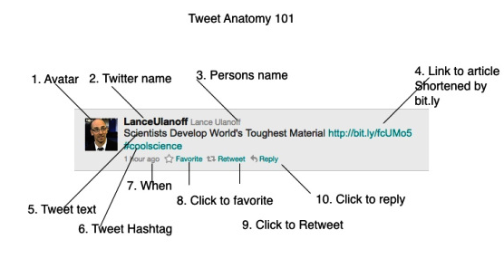
Anatomy of a Tweet

Slide 19
You Found a Great Link – What now?
How do you put this on Twitter?
Open Twitter on computer or mobile device.
Click on text box for new messages.
Describe the resource.
Copy and Paste the URL
Tweet

Slide 20
How About those #@d Symbols?
The @ sign signifies that you are commenting directly to someone (i.e. @jenmalonetn). Once you put the @ symbol in front of a username, the person you are messaging will receive a notification. This comment will be something that will show up on your personal profile page that other people can see, and it will be a comment that will show on the newsfeed of the person you sent it to and your mutual friends. Think of it like “group text messaging”.
Note: There should be no space between the @ symbol and the username.
This is called a hashtag and represents a group topic. When a tweet is put out on Twitter with a hashtag (i.e. #TED or #edchat) in it, then it becomes public for any user to search on Twitter and find out what the Twitter world is saying around the topic of the TED Conference or EdChat.

Slide 21
How About those #@d Symbols?
This is a direct message. It is similar to an email as no one else can see this. It will still be required to meet the character specifications (no more than 140 characters). When you input this you must have a space between the d and the username (i.e. d jenmalonetn). If there is no space (djenmalonetn) it will show up on your newsfeed, and that could get sticky.
This symbol is known as a retweet. It’s basically forwarding a message that you like to all of the people that follow you. This is a great way for messages and links to spread exponentially. A best practice is for you to credit the tweet that you are retweeting. If you click the retweet button on your newsfeed page this will happen automatically. If you use the RT symbol and copy and paste, simply add a (via @username) after the RT.

Slide 22
Caveats Before You Tweet
You should consider all Tweets to be public. Even people who do not have Twitter accounts can visit your Twitter profile and see all of your Tweets.
@Tweets can be seen by everyone on your Twitter profile page. They are also seen in the streams of anyone who follows both you and the person you are sending the @Tweet to.
d Tweets, though private between you and another Twitterer, can be copied and pasted.
Interesting Side Note: All Tweets, except d Tweets, are archived by the Library of Congress
NEVER Tweet personal or identifying information about your students.
Be familiar with your district’s/employer’s social media policies. Educators can be held accountable even for “private” social media use.
Be cautious about Tweeting personal info as well.

Slide 23
Recap: Twitter for PD

Slide 24
How do I grow my PLC?
Participate in Twitter Chats
Use Twitter Tools
Use Hashtags
Scan Lists
Advanced Twitter
In The Pinterest Of Education 17 Ways To Visualize The Twitter Universe 15 Handy Twitter Tips And Tricks 8 Useful And/Or Fun Twitter Tools The 20 Best Pinterest Boards About Educational Technology Twitterize Yourself Into An Infographic Tweet Topic Explorer

Slide 25
Take the 21 Day Twitter Beginner’s Challenge
Take it one step at a time – try the challenge
Day 1 – Create your account and follow some people with similar interests
“Egghead”
Day 2 – Figure out how to change your egghead picture into a nice catchy profile picture (note: you should try to have your twitter pic look like you somewhat, you never know who you’ll run into face to face)
Day 3 – Lurk and figure out how to favorite something.
Day 4 – Retweet someone else’s tweet.
Day 5 – Find a good app to use twitter on your mobile phone or device of choice. (See: Tweetdeck, Hootsuite, the actual Twitter app)

Slide 26
Use Twitter to Promote Your School
Be a cheerleader for your school AND provide your stakeholders up-to- the minute information.
Examples:
@loudoncountysch
@JasonWVance
@FLMSBraves
@TNeduCommish

Slide 27
Resources
Questions?
Teachers Tech Lounge – Twitter for Professional Development Page
Sandy Kendall Livebinder – Twitter for Professional Development
Cyberwise Twitter Guide

Slide 28
Contact Information
Jennifer Malone
Loudon County Schools
Technology/Middle School Supervisor
Twitter: @jenmalonetn
www.loudoncounty.org
jm@loudoncounty.org
(865) 986-4970 X4601

